Slide 1
Research of the best restaurant location in Minsk
Data Science Capstone Project
Anastasia Gerasimovich

Slide 2

Background
Developing business sector
Investors’ high interest
No adequate research

Slide 3
Problem and assumptions
High demand on popular locations research
Goal: specify most prospective locations in Misnk to open a restaurant
Sufficient data volume available
Assumption: Foursquare data set is descriptive and sufficient

Slide 4
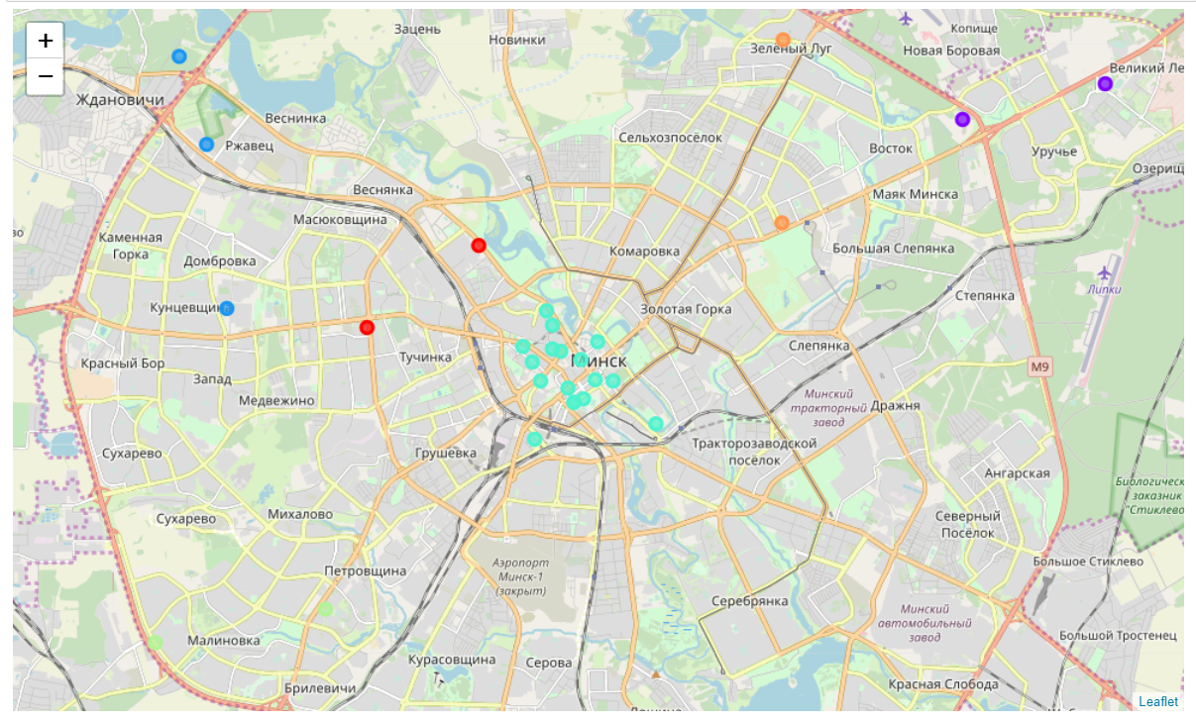
Exploratory Data Analysis

Slide 5
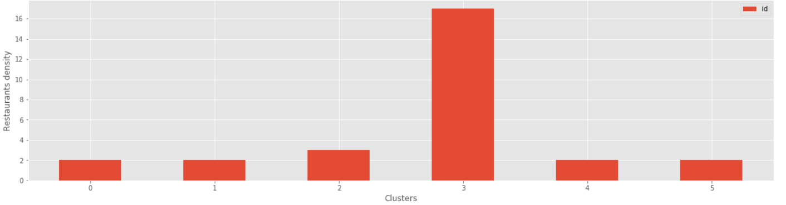
Clusters density

Slide 6
Conclusions
Clustering model and exploratory analysis executed
The new restaurant should be located not more than 1916 meters away from Minsk center
New available data to be explored
Model to be refined with additional data in future

Slide 7

Thank you for attention!

